Slide 1
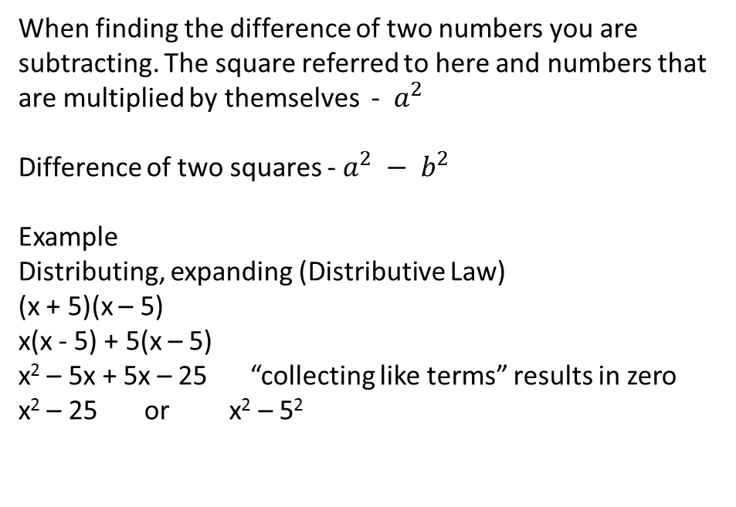
24
7
30
Date
Difference of two Squares
EQ – What are they and how do you work with them
When finding the difference of two numbers you are subtracting. The square referred to here and numbers that are multiplied by themselves - $a^{2}$
Difference of two squares - $a^{2} − b^{2}$
Example
Distributing, expanding (Distributive Law)
(x + 5)(x – 5)
x(x - 5) + 5(x – 5)
x² – 5x + 5x – 25 “collecting like terms” results in zero
x² – 25 or x² – 5²
5
Notes:
Input

Slide 2
24
7
30
Date
Difference of two Squares
EQ – What are they and how do you work with them
Example
Factorising
x² – 25
x² – 5²
(x + 5)(x – 5)
Example 2
Distribute
(2x + 3)(2x – 3)
4x² – 9
Factorise – 4x² - 9
(2x)² – 3²
(2x + 3)(2x – 3)
5
Notes:
Input

Slide 3
Activity
Dwyer Text Page 76
Notes:
Independent practice

Slide 4
Closure activity
Thumbs up
Notes:
Closure

